Slide 1
Nebraska Broadband Office BEAD Program
Challenge the Broadband Map and Ensure Quality Internet Service

Slide 2
Agenda
Definitions
Comments to the Initial Proposal
State of Nebraska’s Internet
Existing Broadband Funding
Community Anchor Institutions
Broadband Map Challenge Process

Slide 3
Definitions
Access: The availability of Broadband in a given area
Broadband: High-speed internet access
Challenge: The process by which we update the Broadband Map to reflect the actual availability of broadband at a location
Nebraska Broadband Map: This map summarizes broadband service availability across Nebraska.
Provider: An ISP, telephone company, cable company or other carrier that offers high-speed communications to homes and businesses
Speed: Download and upload speeds in megabits per second (Mbps)
Unserved: Speeds below 25 Mbps download/3 Mbps upload
Underserved: Speeds at or greater than 25 Mbps download/3 Mbps upload but less than 100 Mbps download/20 Mbps upload

Slide 4
Your Comments
In what ways can the Nebraska Broadband Map be more accessible?
How can the Nebraska Broadband Map make the Initial Proposal more understandable?
As part of the Initial Proposal Volume 1, how can the Broadband Office better help you challenge the Nebraska Broadband Map to ensure you are provided quality Internet service?
In the Initial Proposal Volume 1, has the office accounted for all qualified Community Anchor Institutions (CAI)?
Per the Initial Proposal Volume 1, are there CAIs that you believe do not have access to 1Gbps internet service that have not already been accounted for by the Nebraska Broadband Map?

Slide 5
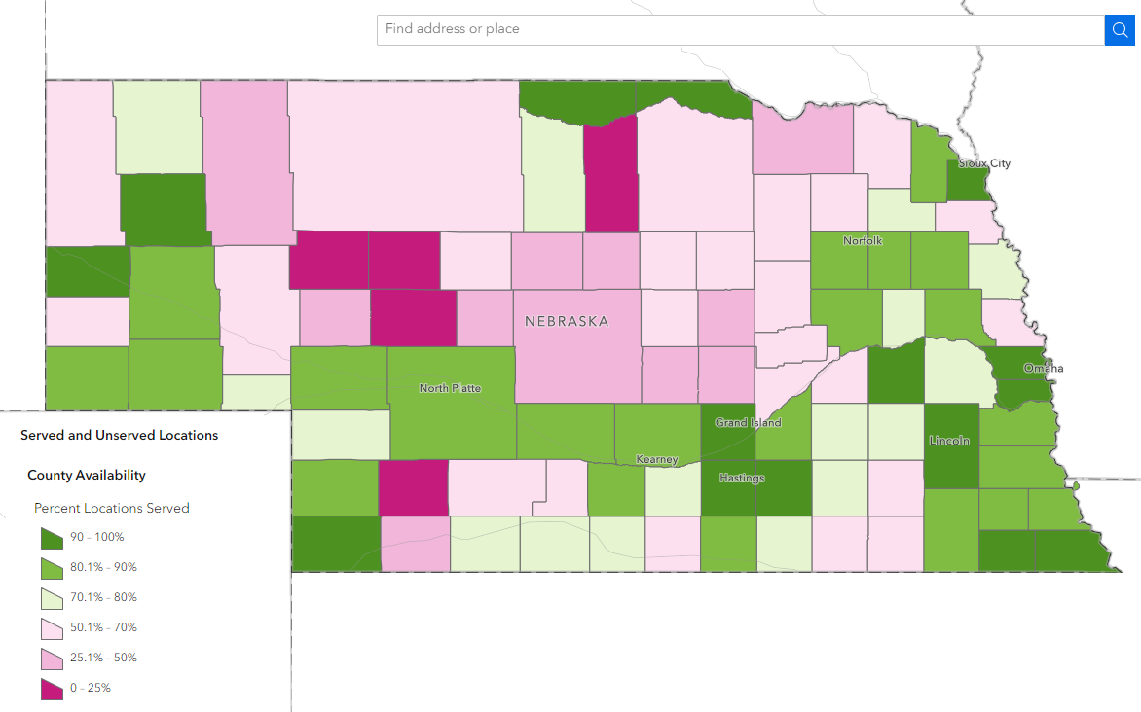
State of Nebraska’s Internet

Slide 6
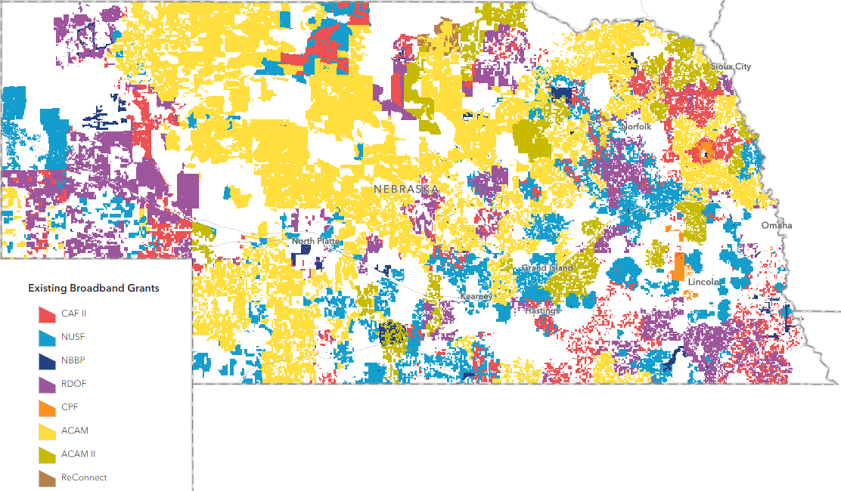
Existing Broadband Funding

Slide 7
Community Anchor Institutions
A Community Anchor Institution is:
A community support organization that facilitates greater use of broadband service by vulnerable populations, including, but not limited to, veterans, rural individuals, low-income individuals, unemployed individuals, children, the incarcerated, and aged individuals.
In Nebraska that means:
Both Public and Private Schools
Libraries
Health clinic, health center, hospital, or other medical providers:
Public safety entities such as firehouses and police stations
Colleges and Universities
Federally Recognized Public housing organizations
Community Support Organizations such as Senior Centers
Why do we need CAIs?
These are places that are rooted in local communities and help individuals and local groups fully utilize the resources made available by broadband.

Slide 8
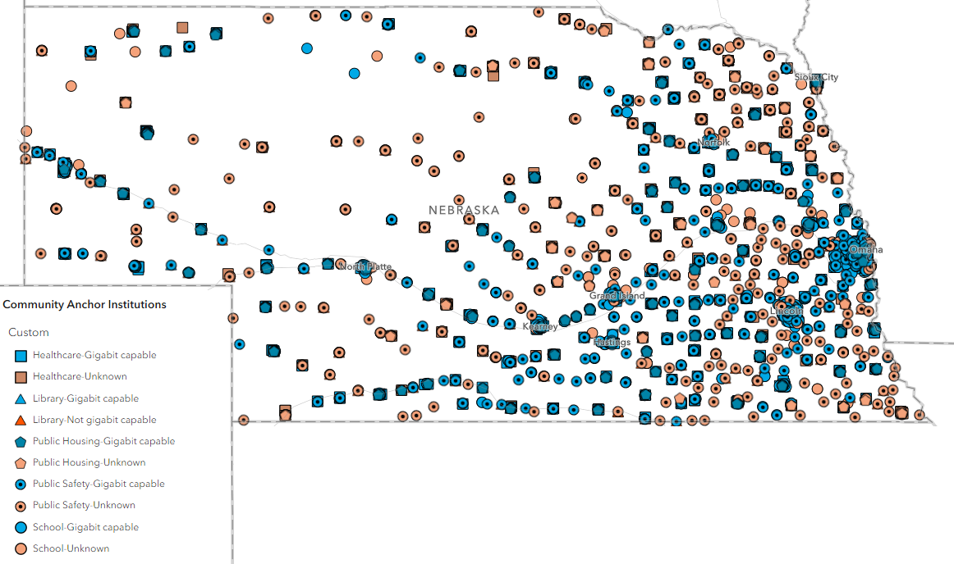
Map of Community Anchor Institutions

Slide 9
Challenge Process
It is important to verify that you are accurately represented as served, underserved, or unserved on the Nebraska Broadband Map.
The Office is only allowed to accept challenges from:
nonprofit organizations;
local and tribal governments; and
broadband service providers.
A challenge guide will be made available on December 22, 2023, prior to the start of the Challenge Period in early January.

Slide 10
Challenge Process Timeline
Publication of Eligible Locations
Prior to beginning the Challenge Phase, NBO will publish the set of BSLs eligible and ineligible for BEAD funding.
Challenge Phase
The Challenger will submit through the NBO challenge portal. It will be visible to the challenged ISP. The portal will notify the provider of the challenge through an automated email, which will include related information about timing for the provider’s response.
Rebuttal Phase
Only the challenged ISP may rebut the challenge causing the location or locations to enter the “disputed” state. If a challenge that meets the minimum level of evidence is not rebutted, the challenge is sustained. A provider may also agree with the challenge.
Final Determination Phase
NBO will make the final determination of the classification of the location, either declaring the challenge “sustained” or “rejected.”
On or about January 3, 2024
Challengers will have 30 calendar days: January 3, 2024 to February 2, 2024
Providers will have 30 business days: February 3 to March 16, 2024.
The NBO will make a final challenge determination within 30 calendar days: March 17 to April 16, 2024

Slide 11
Questions?

