Slide 1
Quick Reference Guide CHALLENGE PERIOD
Nebraska Broadband Office

Slide 2
About the Nebraska Broadband Office (NBO)
Under the Broadband, Equity, Access, and Deployment (BEAD) Program, Nebraska will receive just over $405M to connect every household and business who does not yet have access.
Our goal: every Nebraskan will have access to high-speed internet.
Patrick Haggerty, Director
Patrick Redmond, Deputy Director
Diane Lowe, DHA, Grants and Budget Administrator
Rachel Kilcoin, External Affairs Manager

Slide 3
An Overview of BEAD
BEAD is the federal program administered by the National Telecommunications and Infrastructure Administration (NTIA) intended to address issues of BEAD.
The BEAD program provides federal funding for grants for broadband planning, deployment, mapping, equity, and adoption activities.
Read more at our BEAD FAQ page

Slide 4
Bead Process Overview
5 – Year Plan
Approved
Initial Proposal Volume 1
Submitted, Awaiting NTIA Approval
Initial Proposal Volume 2
Submitted Dec. 22, 2023
Challenge Process
Estimated January – April
Letters of Intent
Estimated Summer 2024
Application Process
Estimated
Fall 2024

Slide 5
Key Definitions
Served: Speeds ≥ 100/20 Mbps
Underserved: Speeds ≥ 25/3 Mbps and < 100/20 Mbps
Unserved: Speeds < 25/3 Mbps
Speeds are displayed in a download/upload format.
NTIA Latency Limit: < 100 ms
ISP: Internet Service Provider
Advocate: A local/tribal government office, nonprofit, or ISP authorized to submit challenges to the Nebraska Broadband Availability Map.
CAIs: Community Anchor Institution A school, library, health clinic, health center, hospital or other medical provider, public safety entity, institution of higher education, public housing organization (including any public housing agency, HUD-assisted housing organization, or Tribal housing organization), or community support organization that facilitates greater use of broadband service by vulnerable populations, including, but not limited to, low-income individuals, unemployed individuals, children, the incarcerated, and aged individuals.

Slide 6
The Challenge Process & Timeline
The purpose of the challenge period is to ensure the accuracy of the Nebraska Broadband Availability Map. Everyone in Nebraska is encouraged to verify the service they receive at their home and/or business is accurately reflected on the map. If not, a challenge should be filed to correct it. The process is expected to begin in early to mid January pending approval of Volume 1.
30 days
Nebraskans verify map and submit challenges if necessary
30 days
ISPs review challenges, submit evidence of rebuttals
30 days
NBO make determinations on challenges and submits to NTIA

Slide 7
How Do Challenges Happen?
BEAD challenges can be submitted by Advocates - Local Governments, Non-Profits, and ISPs
BEAD challenges can be submitted in either direction
Location can be challenged as served
Location can be challenged as unserved/underserved
The BEAD Challenge Process can be used to identify CAIs
The BEAD Challenge Process has multiple, defined challenge types with required challenge and rebuttal evidence.

Slide 8
Types of Challenges
(A) Availability
(S) Speed
(L) Latency
(D) Data cap
(T) Technology
(B) Business service only
(E) Enforceable Commitment
(P) Planned service
(N) Not part of enforceable commitment
(C) Location is a CAI
(R) Location is not a CAI

Slide 9
What every Nebraskan can do:
Follow these steps to ensure the accuracy of the map at your home and or business:
Go to our map
Enter your address in the search bar
Zoom in until you see the dot over your location
Right click on your dot and verify information
You’re done!
Is the information accurate?
YES
NO
Contact an Advocate to submit a challenge

Slide 10
Advocates Submitting Challenges
Step 1: Sign into portal
Step 2: Identify type of challenge
Step 3: Gather evidence from individual/business
All evidence must be in writing or screenshot
Step 4: Upload evidence
Step 5: Submit challenge
Registration and training will be provided for advocates on how to submit via the portal.

Slide 11
The Nebraska BEAD Challenge Portal

Slide 12
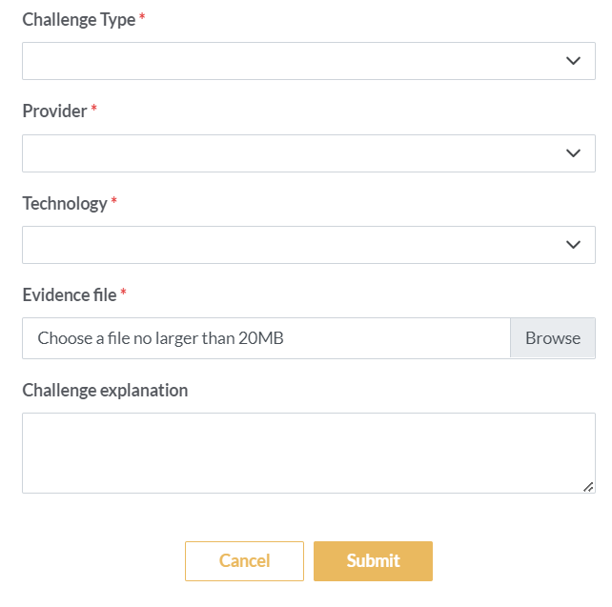
Submitting a Challenge
Search for location address
Click on the “dot” on the map over the location
Review information provided
If information is inaccurate, fill out challenge information
Submit

Slide 13
ISP Rebuttal Process
ISPs can submit challenges as well as rebut. Only providers named in a challenge will be able to rebut.
Once a challenge has been submitted, ISPs will:
Receive notification of a challenge
All challenges will be posted to the website
Determine if rebuttal is required
If not, accept without dispute
If required, move to next step
Collect evidence
Submit rebuttal through portal
Registration and training will be provided for ISPs on how to submit via the portal.

Slide 14
Challenge Type – (A) Availability
Description: The broadband service identified is not offered at the location, including a unit of a multiple dwelling unit (MDU).
Allowed Evidence:
Screenshot of provider webpage.
A service request was refused within the last 180 days (e.g., an email or letter from provider).
Lack of suitable infrastructure (e.g., no fiber on pole).
A letter or email dated within the last 365 days that a provider failed to schedule a service installation or offer an installation date within 10 business days of a request.
A letter or email dated within the last 365 days indicating that a provider requested more than the standard installation fee to connect this location or that a provider quoted an amount in excess of the provider’s standard installation charge in order to connect service at the location.
Permissible Rebuttals:
Provider shows that the location subscribes or has subscribed within the last 12 months, e.g., with a copy of a customer bill.
If the evidence was a screenshot and believed to be in error, a screenshot that shows service availability.
The provider submits evidence that service is now available as a standard installation, e.g., via a copy of an offer sent to the location.

Slide 15
Challenge Type – (S) Speed
Description: The actual speed of the service tier falls below the unserved or underserved thresholds.
Allowed Evidence:
Speed test by subscriber, showing the insufficient speed and meeting the requirements for speed tests.
Screen shots of speed test
Permissible Rebuttals:
Provider has countervailing speed test evidence showing sufficient speed, e.g., from their own network management system.

Slide 16
Challenge Type – (S) Speed: Speed Test Requirements
The NBO will accept speed tests as evidence for substantiating challenges and rebuttals. Each speed test consists of three measurements, taken on different days. Speed tests cannot predate the beginning of the challenge period by more than 60 days.
Speed tests can take four forms:
A reading of the physical line speed provided by the residential gateway, (i.e., DSL modem, cable modem for HFC, ONT for FTTH), or fixed wireless subscriber module.
A reading of the speed test available from within the residential gateway web interface.
A reading of the speed test found on the service provider’s web page.
A speed test performed on a laptop or desktop computer within immediate proximity of the residential gateway, using either of the two below speed test services:
Ookla: https://www.speedtest.net/
M-Lab: https://speed.measurementlab.net/

Slide 17
Challenge Type – (S) Speed: Speed Test Requirements (cont’d)
Each group of three speed tests must include:
The name and street address of the customer conducting the speed test.
A certification of the speed tier the customer subscribes to (e.g., a copy of the customer's last invoice).
An agreement, using an online form provided by NBO, that grants access to these information elements to the broadband office, any contractors supporting the challenge process, and the service provider https://speed.measurementlab.net/
More information is available on the website: broadband.nebraska.gov/challenge

Slide 18
Challenge Type – (L) Latency
Description: The round-trip latency of the broadband service exceeds 100 ms.
Allowed Evidence:
Speed test by subscriber, showing the excessive latency.
Permissible Rebuttals:
Provider has countervailing speed test evidence showing latency at or below 100 ms, e.g., from their own network management system or the Connect America Fund (CAF) performance measurements.

Slide 19
Challenge Type – Others
All other challenge types are outlined on our website:
https://broadband.nebraska.gov/challenge/challenge-types/

Slide 20
Advocate Registration
Contact NBO to register your government office, non-profit, or ISP to become an Advocate for challenges.
ndot.broadbandoffice@nebraska.gov
402.479.4756
Step-by-step instructions will be available at our website once the portal is finalized.

Slide 21
Results
Results will be published on our website at broadband.nebraska.gov.
Visit our website @ broadband.nebraska.gov Follow us on Facebook @ www.facebook.com/nebraska.broadband.office

Slide 22
Questions?
Check our FAQs broadband.nebraska.gov/Challenge
Email Us NDOT.BroadbandOffice@nebraska.gov
We request all questions be submitted in writing. We will post questions and responses on our website to assist everyone through the process.
Together, we'll build a bright future rooted in the Good Life, with great things on the horizon.

