Slide 1

NBEAD Technical Assistance
Section 106: Nebraska State Historic Preservation Office
Stormwater Mitigation
Notes:
Welcome and thank you all for attending!
We are recording this call. The recording and the slides will be posted to the website later.

Slide 2
March 13 TA Call changes
Planned focus on reporting
NA unless subgrants are executed
Replacing with calls with individual subgrantees

Slide 3


Agenda
Tribal Consultation
Section 106 with the Nebraska State Historic Preservation Office
Q&A
Construction Stormwater Permitting
Stormwater Pollution Prevention Plan
Q&A
Notes:
Today we will have a presentation from Mariska Molnar from the Nebraska State Historic Preservation Office on Section 106 and their review process. Mariska will end her presentation with a time for questions.
And then we will jump into the Nebraska Department of Water, Energy and Environment’s Construction Stormwater Permit and the Stormwater Pollution Prevention Plan.
We will end the call with a Q&A session. If you have questions throughout the presentation, you can put them in the chat or wait and ask them at the end!

Slide 4
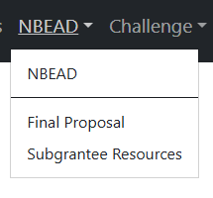
Website Resources
NBEAD/Subgrantee Resources
NEPA/Permitting questionnaire
SOPs/step-by-step instruction guides
DPA environmental summaries
Last week’s slides & recording
Notes:
We again, wanted to remind you about the Subgrantee Resources page on our website. It has tons of great resources to help you through the NEPA review process!

Slide 5

Section 106 Tribal Consultation
NTIA coordinated & completed
No Tribes responded
Projects are not impacted
Not the same as Resolution of Consent
Notes:
Amber come up with stuff here….. NTIA handles initial notification. Already done. No requests for consultation. No longer a concern or thing to handle.

Slide 6
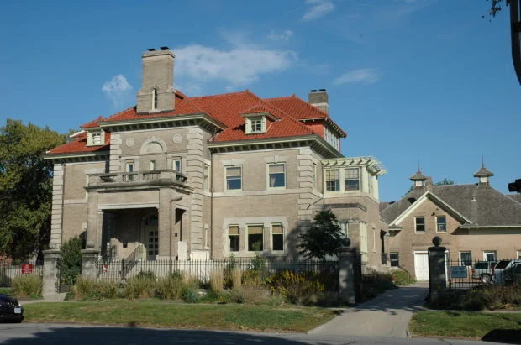
NE State Historic Preservation Office
NEPA Section 106
Mariska Molnar
Preservation Archeologist
Nebraska State Historic Preservation Office
Notes:
On that note, I would like to welcome Mariska Molnar from NE SHPO to the call! Thank you, Mariska for joining us!

Slide 7

Section 106: Review and Compliance
Mariska Molnar
Preservation Archeologist
Nebraska State Historic Preservation Office
Mariska.Molnar@Nebraska.gov

Slide 8
Why does Section 106 exist?

Slide 9
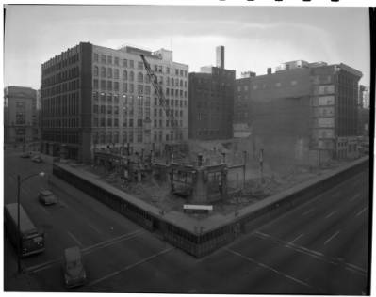
National Historic Preservation Act of 1966
Congress established a program to preserve the historical and cultural foundations of the nation as a part of community life.
SHPOs in every state and territory
National Register of Historic Places
Tax Credit Programs
THPOs
Section 106 Reviews
Was enacted in response to the Urban Renewal Act and the Interstate Highway Act, which had been fundamentally changing the way our cities looked and functioned

Slide 10
What is Section 106?
Codified in law via National Historic Preservation Act (NHPA) §36 CFR Part 800
Federal undertaking: projects involving federal funding, federal land, a federal license, or a federal permit
Often the state government subgrants federal money which is what triggers the Section 106 review process
Federal agencies must consider the potential effects of their undertakings
Requires SHPO to review federal undertakings to assess potential effects to historic properties within a 30-day review period
Encourages but does not mandate preservation

Slide 11
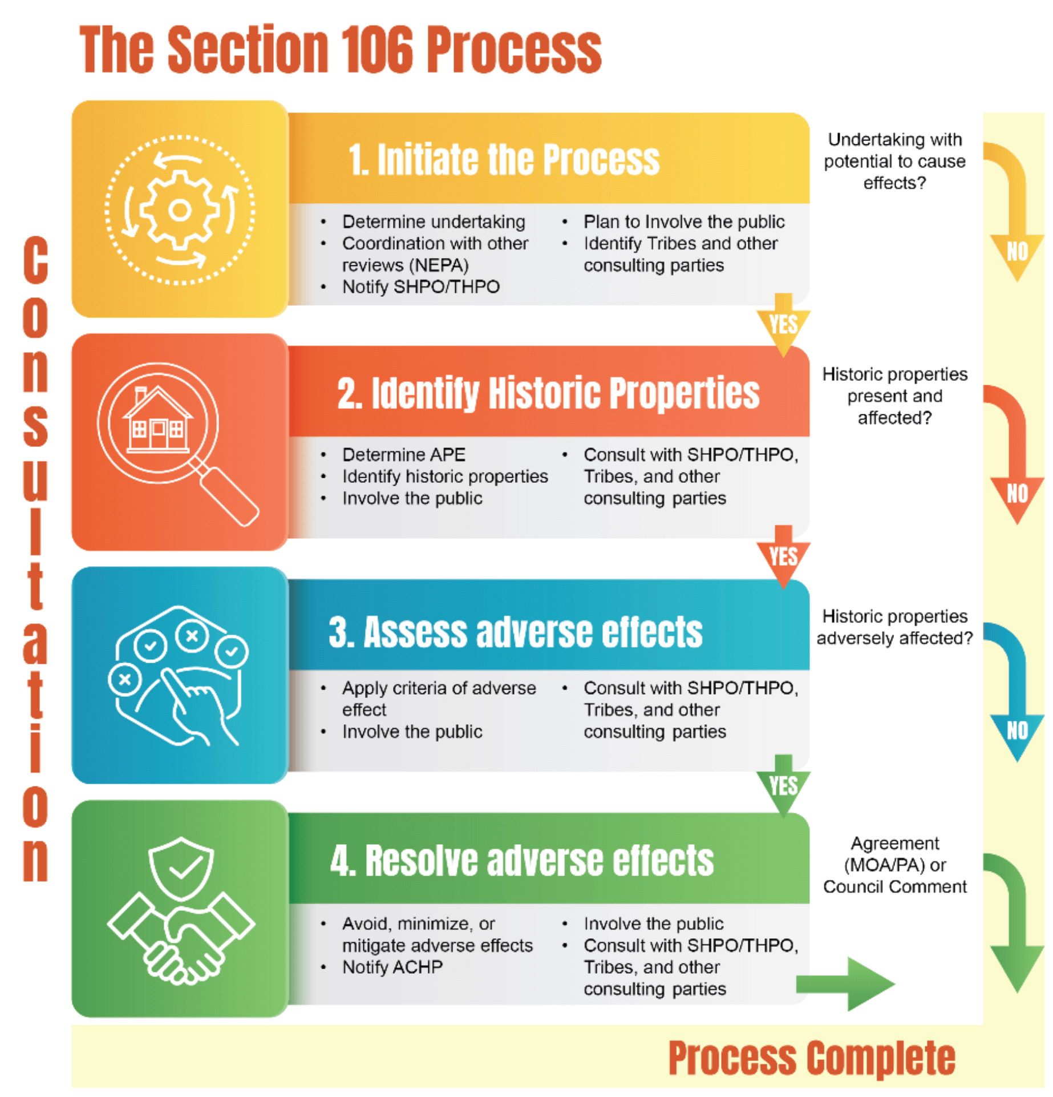
Section 106 Review Process (in theory)
Initiate Section 106 Review (Applicant)
Identification of Historic Properties (NESHPO)
Assessment of Effects to Historic Properties (NESHPO)
Resolution of Adverse Effects
(Applicants/ACHP/NESHPO)

Slide 12
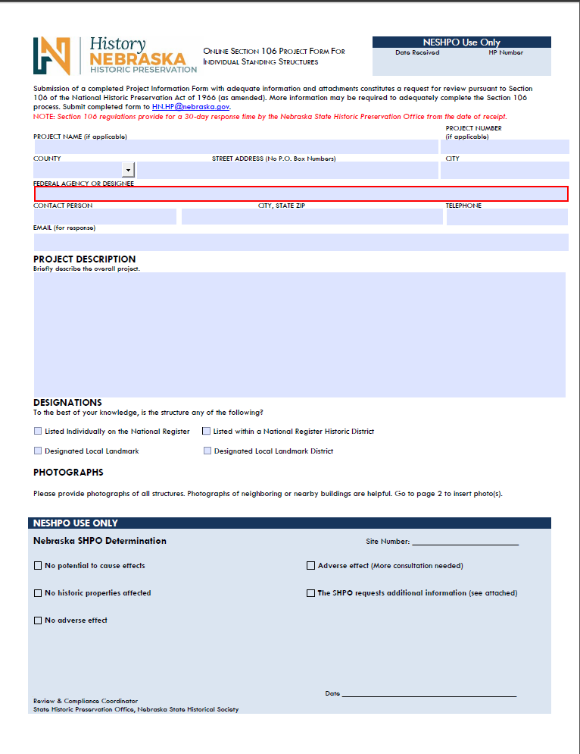
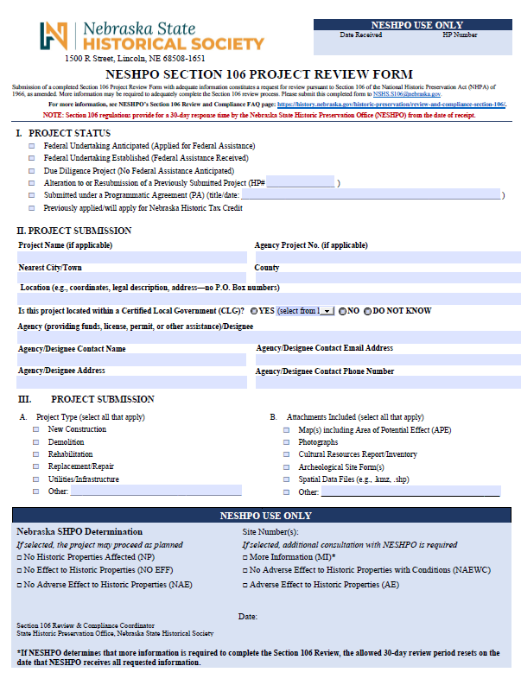
Initiation of Section 106 Review
Federal agency (or designee) submits a request for review to our office.
Determine if there is an undertaking.
Any activity with federal funding that could have an effect on historic properties.
Federal Agency or designee determines if the property is listed individually, in a historic district, or eligible for listings.
If you are wondering whether a property will be considered historic prior to the Section 106 Process our office is always happy to consult on preliminary determinations of eligibility
Notes:
Talk a bit on Phase I, II, and III

Slide 13
What Do We Consider in the Review Process?
For all types of projects:
What type of resource is it?
Is it in an existing historic district or eligible one?
Is it already listed on the National Register of Historic Places?
Has the area been surveyed before with a National Register determination previously made?
Does the building or site still retain its historic integrity?
How will the proposed undertaking affect the qualities that qualify it for listing on the National Register?
What makes a property significant enough to be on the National Register?
Criterion A: Association with significant events or patterns of events
Criterion B: Association with the lives of persons significant to our past
Criterion C: Architectural significance
Criterion D: Ability to yield future information

Slide 14
Assessment of Effects to Historic Properties
IF NOT LISTED/NOT ELIGIBLE: The project receives a quick “No Historic Properties Affected” sign off
IF IT IS LISTED/ELIGIBLE: We study the project plans and try to anticipate their effects on historic properties, using the Secretary of the Interior’s (SOI) Standards for the Treatment of Historic Properties
After we have reviewed the proposed scope of work and have determined the property is historic then either a No Adverse Effect, No Adverse Effect with Conditions, or Adverse Effect determination is issued
No Historic Properties: The resource is not considered eligible for the NRHP
No Adverse Effect: Potentially eligible/eligible/listed resources present but the scope of work has no adverse effect on the resources ability to convey its historic significance or integrity
No Adverse Effect with Conditions: Potentially eligible/eligible/listed resources present but the activities proposed can be modified to avoid adverse effects to historic features.
Adverse Effect: Potentially eligible/eligible/listed resources present but the scope of work cannot be modified to avoid adverse effects requiring mitigation for the project to proceed.

Slide 15
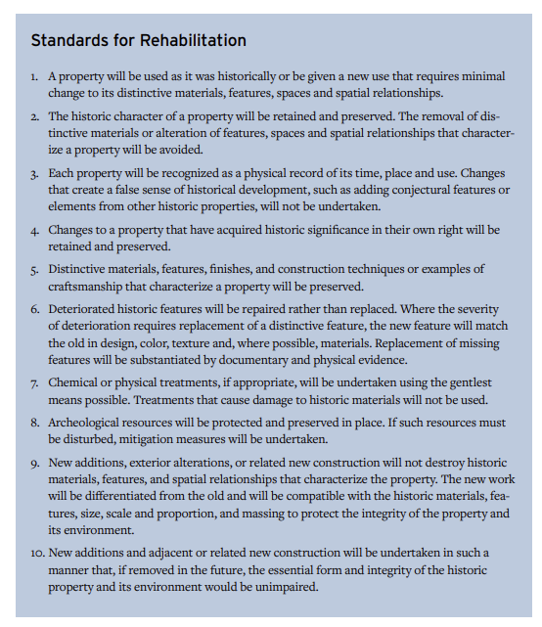
Secretary of the Interior's Standards
National standards for the preservation, rehabilitation, restoration, or reconstruction of historic structures
National Park Service Preservation Breifs provide treatment recommendations for the most historically appropriate substitute materials and restoration techniques
If a property is determined eligible for the National Register and the scope of work does not meet the Secretary of the Interior’s standards, then an Adverse Effect is issued

Slide 16
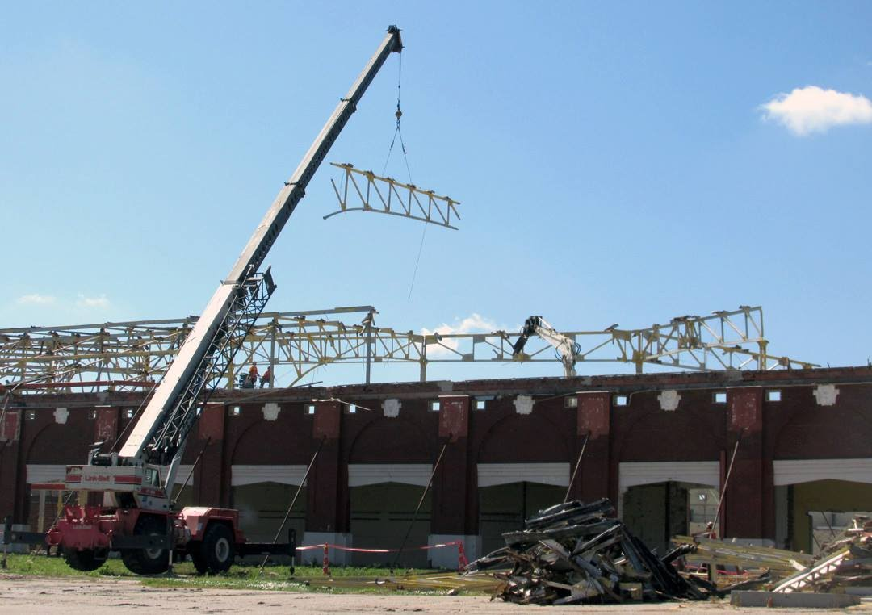
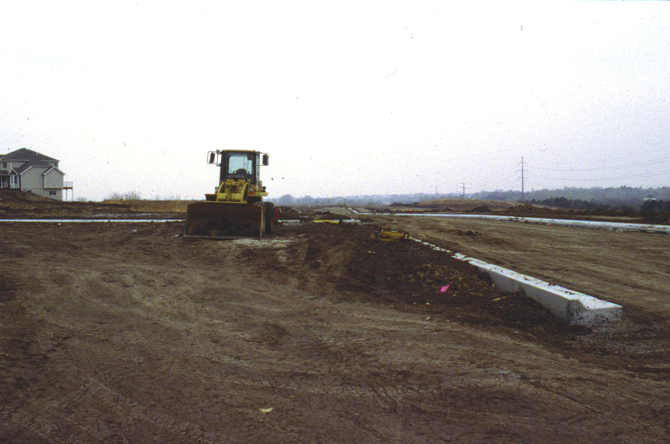
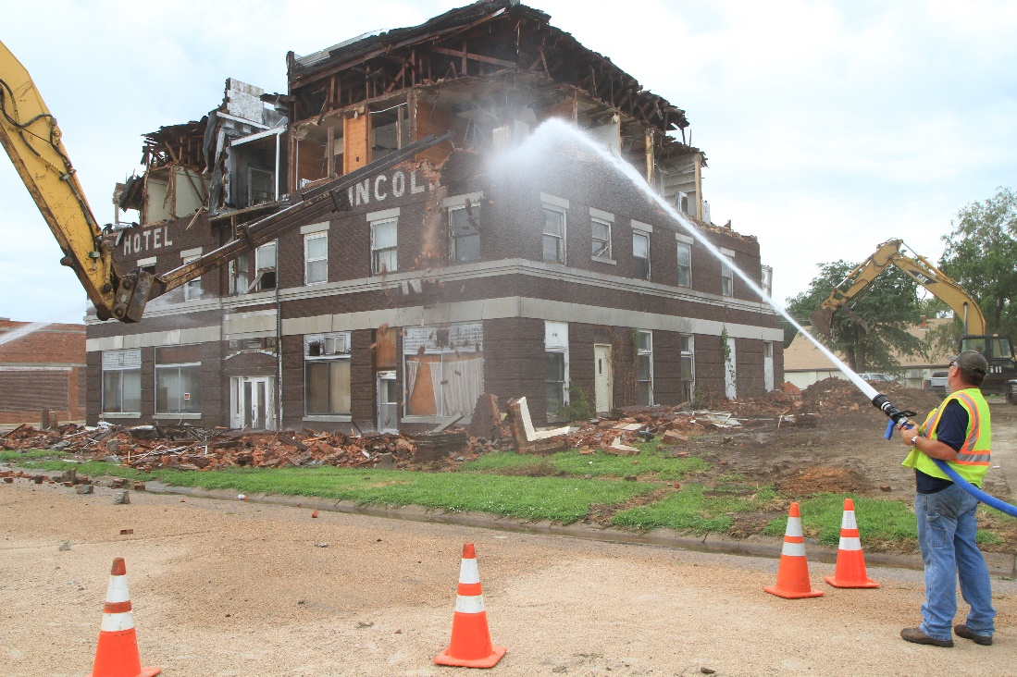
Adverse Effects
Examples: Physical destruction or damage, alteration, or moving of a historic resource to a new location

Slide 17
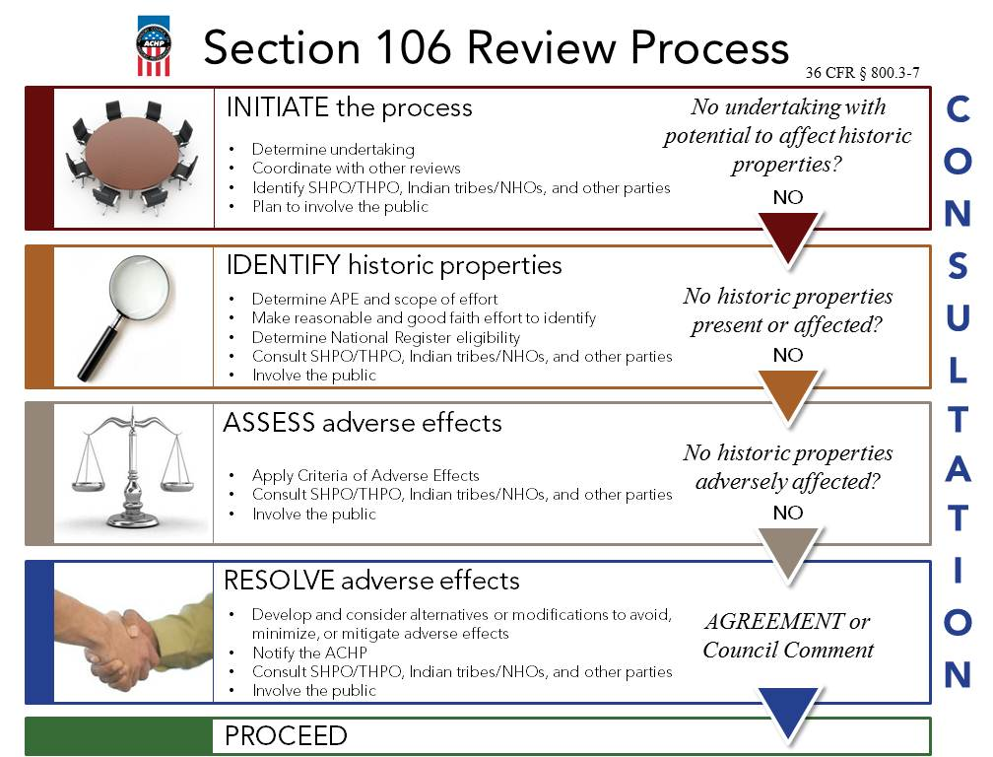
Adverse Effects Process
The SHPO will try and work with the applicant to get a No Adverse Effects with Conditions determination. However if this is not possible, then the SHPO will issue an Adverse Effect determination which will require the applicant to reach out the the Advisory Council on Historic Preservation (ACHP) to see if they would like to be part of the mitigation process (the ACHP responds within 15-30 days).
Once the ACHP has decided if they would like to participate, the federal agency that is responsible for the undertaking will propose mitigation strategies, and the SHPO will concur or suggest appropriate alternatives. Once a mitigation plan has been agreed upon then a Memorandum of Agreement (MOA) is written and signed by the SHPO and Federal agency/designee.

Slide 18
Mitigation of Adverse Effects
SHPO and designee consult “to develop and evaluate alternatives or modifications that could AVOID, MINIMIZE, or MITIGATE adverse effects.
Consider Alternatives (e.g., different materials and/or locations, alternative methods, etc.) Resolution may include finding some creative way to do something for the public benefit, if nothing else (e.g., informational panels, documentation, similar national register nomination, survey of a specific type of resource). However, it is important to note the agency proposing the Adverse Effect is responsible for proposing mitigation projects and is not done until after the Adverse Effect determination has been officially made.
Resolution agreed on? The NESHPO will write a Memorandum of Agreement (MOA) to document what each party is responsible for. Traditionally, recordation is done prior to the work being started, and other mitigation efforts are done within a year of the project’s completion. Timelines can be flexible based on the needs of the applicant.

Slide 19

Questions?

Slide 20
Glossary
ACHP: Advisory Council on Historic Preservation, federal entity that oversees Section 106
Designee: A party identified by a federal agency to complete tasks, such as Section 106, in their name. Often have to meet specific requirements.
MOA: Memorandum of Agreement, a document outlining what both parties agree to in order to mitigate an adverse effect
NHPA: National Historic Preservation Act
NRHP: National Register of Historic Places
SHPO: State Historic Preservation Office/Officer
THPO: Tribal Historic Preservation Office/Officer
Undertaking: Any activity or project that will be receiving federal funds that could impact historic resources

Slide 21
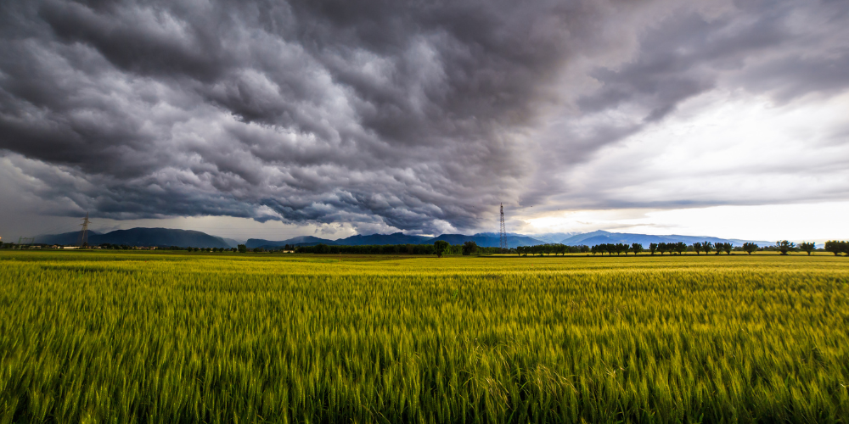

Construction Stormwater (CSW) Permitting
Who needs it and when?
Notes:
As I mentioned last week, there are some environmental permits that you will be required to get before you can begin construction. While these permits are not always directly asked about in NBO’s NEAP form, it is still a good idea to mention them. We will be asking about these later – throughout reporting. As always if you have questions don’t hesitate to ask!
We are going to jump into another permit that you might need for your project!

Slide 22

Construction Stormwater Permitting
Issued by the Nebraska Department of Water, Energy, and Environment (DWEE)
Construction stormwater permits ensure compliance with the Clean Water Act at the state level
Notes:
Last week I talked about the Clean Water Act and the requirements at the federal level with the US Army Corps of Engineers. Today we will look at the requirements at the state level with the NE Dept of Water, Energy, and Environment.
The same way the Section 404 permits ensure you are following Clean Water Act requirements at the federal level, the construction stormwater permit ensure you are following state requirements, including construction deposits.

Slide 23
When is a CSW Permit Required?
1 acre or more disturbance
No continuous distribution
Can be throughout the project area
New permit available in November

Slide 24

CSW Permit Process
Submit a Notice of Intent (NOI) to DWEE
01
Stormwater Pollution Prevention Plan (SWPPP)
NE Game & Parks CERT Review
Receive authorization under the general permit
02
Maintain permit coverage throughout construction
03
Notes:
A Notice of Intent is then submitted to request permit coverage through the DWEE CSW Online-Portal.
You will need to include a Stormwater Pollution Prevention Plan (see the next slides) and your completed CERT Review from the NGPC in the NOI.
Once approved, the project is authorized under the general permit and construction activities may commence.
Permit coverage and the requirements listed in the SWPPP must be maintained for the duration of construction.

Slide 25

Stormwater Pollution Prevention Plan (SWPPP)
The SWPPP identifies erosion and sediment controls to minimize stormwater impacts.
Silt fences
SWPPPs must be implemented and updated as site conditions change.
Notes:
A SWPPP lays out the steps and techniques that will be used to reduce pollutants in stormwater runoff leaving a construction site.
SWPPPS identify potential pollution sources onsite that may come into contact with stormwater runoff.
SWPPPs also describe best management practices (BMP) used to reduce pollutants in the site's stormwater runoff.
SWPPPs must be prepared by qualified personnel and should be kept onsite at all times.

Slide 26

SWPPP Inspections and Compliance
Routine site inspections are required during construction
Inspections verify that stormwater controls are installed and functioning properly
Inspection records must be maintained as part of permit compliance
Notice of Termination (NOT)
Notes:
In accordance with the SWPPP, you must complete routine site inspections throughout the life of the project. These will either need to be completed by you as the subgrantee and project owner or the subcontractor on the project.
Site inspections must occur:
At least once every 7 calendar days OR once every 14 calendar days AND
Within 24 hours of the occurrence of a storm even of 0.25 inches or greater, or the occurrence of snowmelt runoff sufficient to cause discharge
The SWPPP document is updated with changing site conditions and the results of each inspection.
After completion of project activities, a Notice of Termination can be submitted through the DWEE CSW Online Portal.
Within the NOI you will identify an estimated end date. The portal will automatically prompt you to either submit your NOT or you can submit an extension. The permit will not close until you have submitted your NOT.

Slide 27

Reminders
Start early
Work in tandem
Can not begin until subgrants are executed
Submittable form access

Slide 28
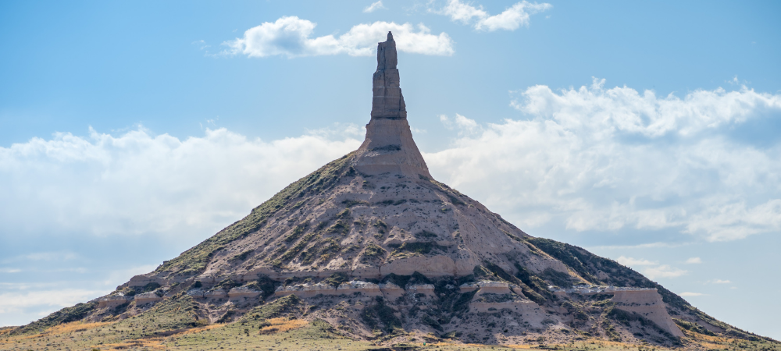
Questions?
Notes:
We will now head into the Q&A session.
Rachel, anything in the chat?
As Director Haggerty mentioned at the beginning of the call, you can not begin the NEPA review process or applying for permits until you have signed your subgrant! Please work with Diane to get your documents submitted and your subgrants executed!

Slide 29

nbo.admin@nebraska.gov
www.broadband.nebraska.gov
Notes:
As Director Haggerty mentioned at the beginning of the call, you can not move forward with your projects until you have signed your subgrants! You will not receive access to the submittable portal to begin the NEPA review process or applying for permits until then! Please work with Diane to get your documents submitted and your subgrants executed!
If you have questions later on, please email nbo.admin@nebraska.gov.
Thank you for attending today’s TA call! We’ll see you next week!

